Slide 1
How to build a chatbot — Amara Keller IBM Developer Advocate @MissAmaraKay
IBM Cloud: http://ibm.biz/ibmcloudchatbot Code pattern: http://ibm.biz/chatbot011718

Slide 2
Guts of a chatbot
Intents
Entities
Dialog

Slide 3
#Intents
An intent is the goal or purpose of the user’s input.
Notes:
An intent is a purpose or goal expressed in a customer's input, such as answering a question or processing a bill payment.

Slide 4
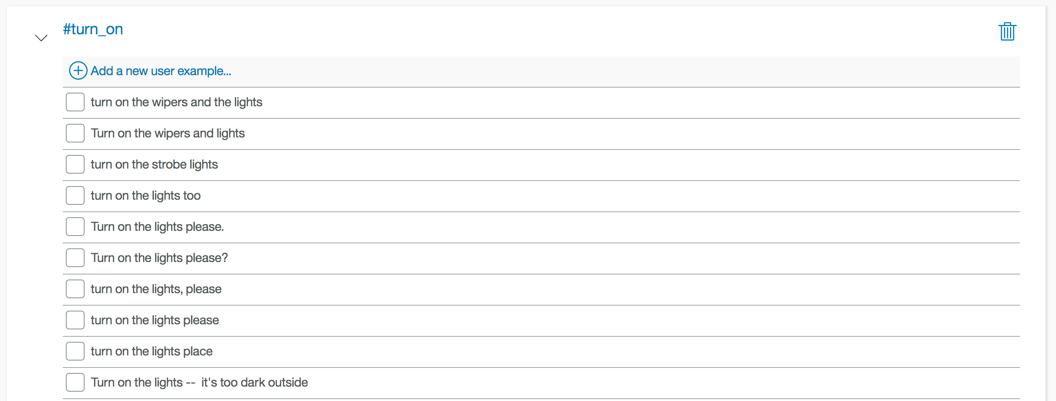
Provide at least five examples for each intent.

Slide 5
@Entities
An entity is a portion of the user’s input that you can use to provide a different response to a particular intent.
Notes:
An entity represents a class of object or a data type that is relevant to a user's purpose. By recognizing the entities that are mentioned in the user's input, the Conversation service can choose the specific actions to take to fulfill an intent.

Slide 6
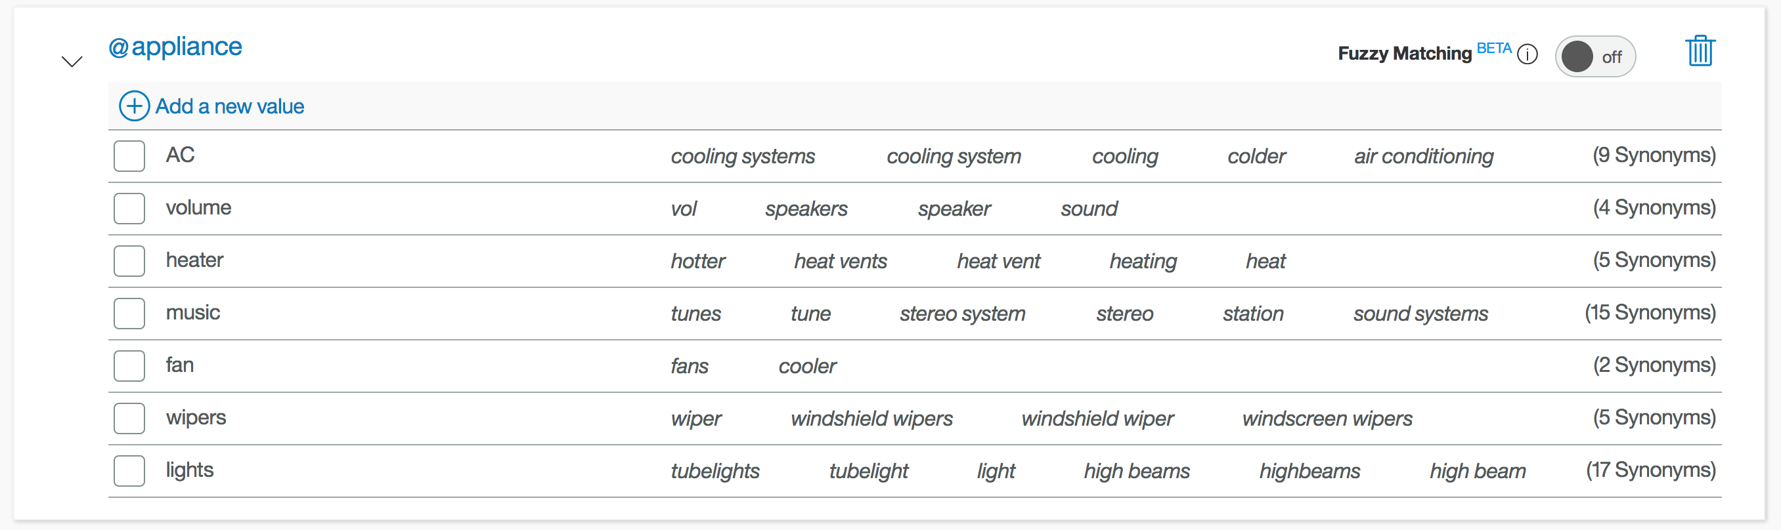
Can use synonyms (like above) or regex patterns.

Slide 7
Dialog
A dialog uses intents, entities, and context from your application to return a response to each user’s input.

Slide 8
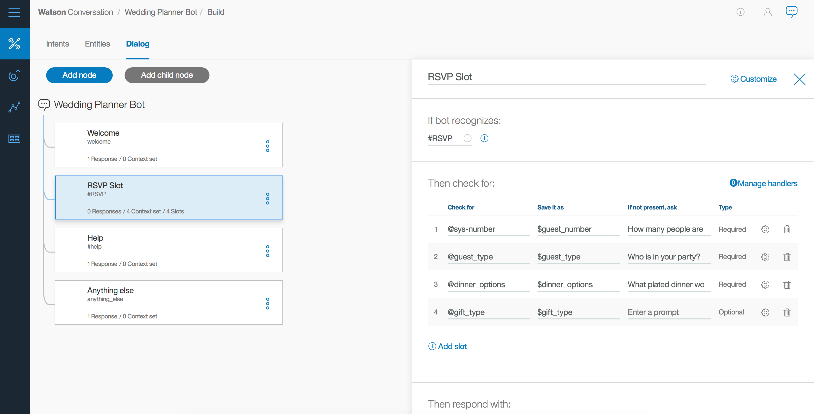

Slide 9
Now you try it!

Slide 10
Messaging Platform
Watson Conversation
2. Parse Intents and Entities
3. Application decides if further action is needed
1. Capture user input
7. Return a response with dynamic data inserted into response.
3b/8. Return response back to user and wait for another user input to repeat process
6. Update context and send to Watson
Application
Third-party API
4. Make API call to get data or perform third-party action
5. Return dynamic data

Slide 11
Thank you
Amara Keller
Developer Advocate
—
amara.keller@ibm.com
@MissAmaraKay

Slide 13
Additional Links
https://developer.ibm.com/code/journey/create-an-investment-management-chatbot/
https://developer.ibm.com/code/journey/create-cognitive-retail-chatbot/
https://developer.ibm.com/code/journey/create-cognitive-banking-chatbot/
https://developer.ibm.com/code/patterns/assemble-a-pizza-ordering-chatbot-dialog/
https://medium.com/@MissAmaraKay
https://github.com/akeller/chatbot-dashbot-workshop

